Slide 1
Atmosphere:
Layers, Temperature, Pressure, Wind, Coriolis Effect

Slide 2
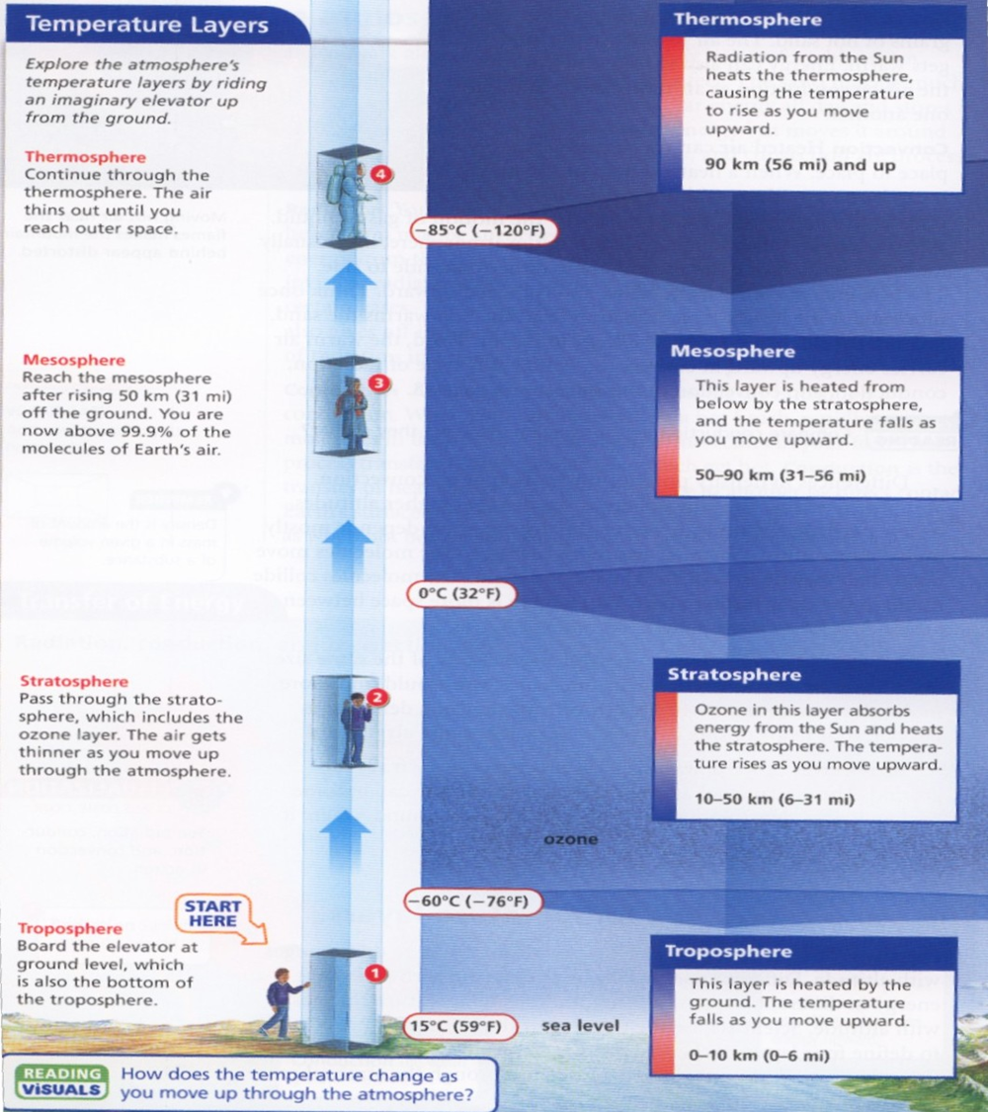
Layers of the Atmosphere
Troposphere
first layer above the surface
contains half of the Earth's atmosphere
Weather occurs in this layer
Heated by the ground
Temperature decreases as you move upward
Stratosphere
Aircrafts fly here because it is very stable.
Ozone layer is located here which absorbs
energy from the Sun as its heat source
Temperature increases as you move upward

Slide 3
Layers of the Atmosphere
Mesosphere
Meteors or rock fragments burn up here
Layer is heated from below by the stratosphere
Temperature decreases as you move upward
Thermosphere
Auroras occur here
Space shuttle orbits here
Layer is heated by radiation from the sun
Temperature increases as you move upward
Exosphere
Where the atmosphere merges into space
Extremely thin
This is the upper limit of our atmosphere.

Slide 4
Absorption & Reflection of Solar Energy
What is effective at absorbing heat?

Slide 5
Transfer of Solar Energy
Conduction – energy transferred from one substance to another through direct contact.
Convection – energy transferred from one place to another by the movement of a gas or liquid.

Slide 7
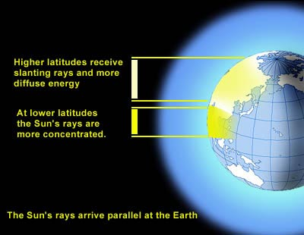
Heating of the Earth

Slide 8
Temperature & Air Pressure
Uneven heating of Earth creates different air pressures (highs and lows).
Air Pressure – Created by the number of air molecules moving and bouncing off an object. (Measured using a barometer.)
Examples:
Warm air = more active air molecules = low air pressure
Ex: equator
Cool air = less active air molecules = high air pressure
Ex: poles

Slide 9
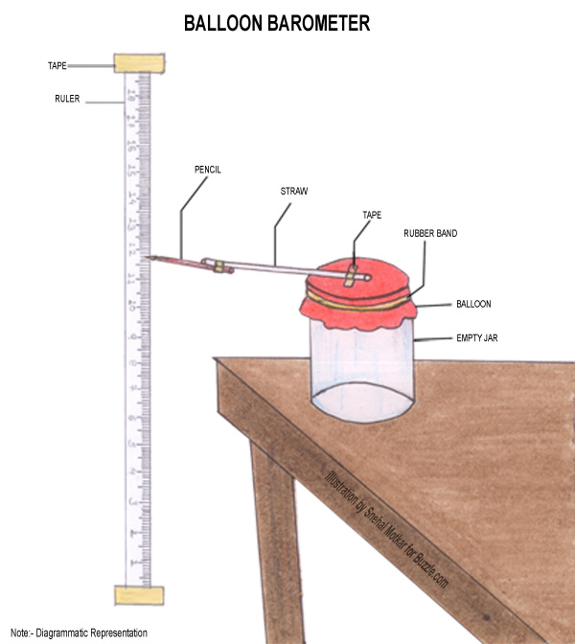
Air Pressure – Created by the number of air molecules moving and bouncing off an object. (Measured using a barometer.)

Slide 10
Elevation & Air Pressure

Slide 11
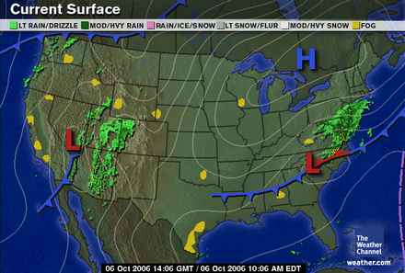
High and Low Air Pressure Systems

Slide 12
Air Pressure & Moisture
Low air pressure usually means warm humid weather (ex: equator). Why?
Warm air causes more evaporation; air molecules are more active & can hold more moisture
High air pressure usually means cooler drier weather. Why?
Less evaporation; molecules are close together holding less moisture.

Slide 13
Low Pressure at Equator

Slide 14
Differences in Temperature & Air Pressure
Remember: uneven heating of the Earth creates differences in air pressure.
What do the differences in temperature and air pressure create?
Wind
How do they create wind?
Air wants to move from an area of high pressure to an area of low pressure

Slide 15
Wind Direction

Slide 16
Sea & Land Breeze Convection Currents

Slide 17
Global Winds
The uneven heating of the earth creating differences in air pressure creates global winds.
At the poles: indirect solar energy; cold temps; high pressure
air sinks and moves towards the equator.
At the equator: direct solar energy; warm temps; low pressure
air rises and moves towards the poles.
The circular movement is called a convection current.

Slide 18
Complex Movement of Global Winds
Why isn’t it as simple as one global wind convection current in each the northern & southern hemisphere?
Earth’s rotation affects wind direction.
The influence of the Earth’s rotation on the movement of air and water is called the Coriolis Effect.
The Coriolis Effect cause global winds to turn:
Northern Hemisphere = clockwise
Southern Hemisphere = counter clockwise

Slide 19
Coriolis Effect

Slide 20
Global Wind Belts & Calm Regions

